Slide 1
Describing Data: Numerical Measures
3
Notes:
‹#›

Slide 2
GOALS
Calculate the arithmetic mean, weighted mean, median, mode, and geometric mean.
Explain the characteristics, uses, advantages, and disadvantages of each measure of location.
Identify the position of the mean, median, and mode for both symmetric and skewed distributions.
Compute and interpret the range, mean deviation, variance, and standard deviation.
Understand the characteristics, uses, advantages, and disadvantages of each measure of dispersion.
Understand Chebyshev’s theorem and the Empirical Rule as they relate to a set of observations.
Notes:
‹#›

Slide 3
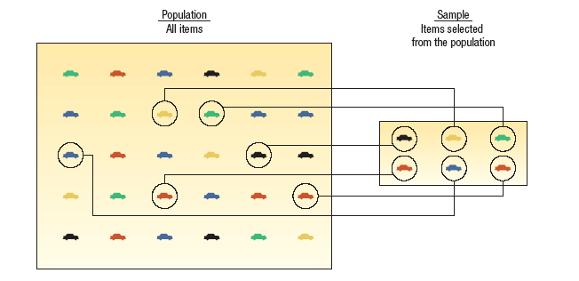
Parameter Versus Statistics
PARAMETER A measurable characteristic of a population.
STATISTIC A measurable characteristic of a sample.
Notes:
‹#›

Slide 4
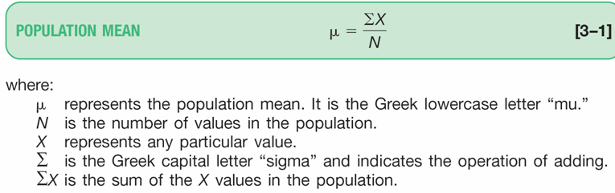
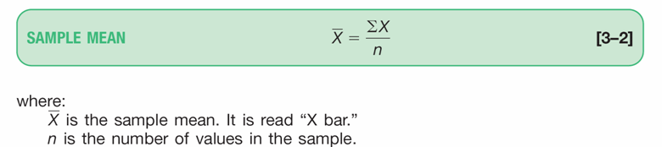

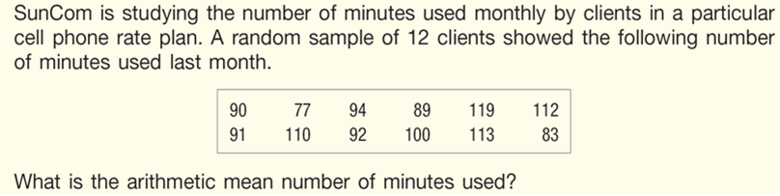
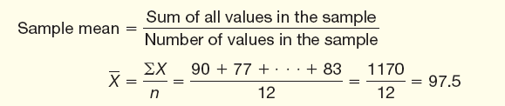
Population Mean
For ungrouped data, the population mean is the sum of all the population values divided by the total number of population values. The sample mean is the sum of all the sample values divided by the total number of sample values.
EXAMPLE:
Notes:
‹#›

Slide 5
The Median
MEDIAN The midpoint of the values after they have been ordered from the smallest to the largest, or the largest to the smallest.
PROPERTIES OF THE MEDIAN
There is a unique median for each data set.
It is not affected by extremely large or small values and is therefore a valuable measure of central tendency when such values occur.
It can be computed for ratio-level, interval-level, and ordinal-level data.
It can be computed for an open-ended frequency distribution if the median does not lie in an open-ended class.
EXAMPLES:
The ages for a sample of five college students are:
21, 25, 19, 20, 22
Arranging the data in ascending order gives:
19, 20, 21, 22, 25.
Thus the median is 21.
The heights of four basketball players, in inches, are:
76, 73, 80, 75
Arranging the data in ascending order gives:
73, 75, 76, 80.
Thus the median is 75.5
Notes:
‹#›

Slide 6
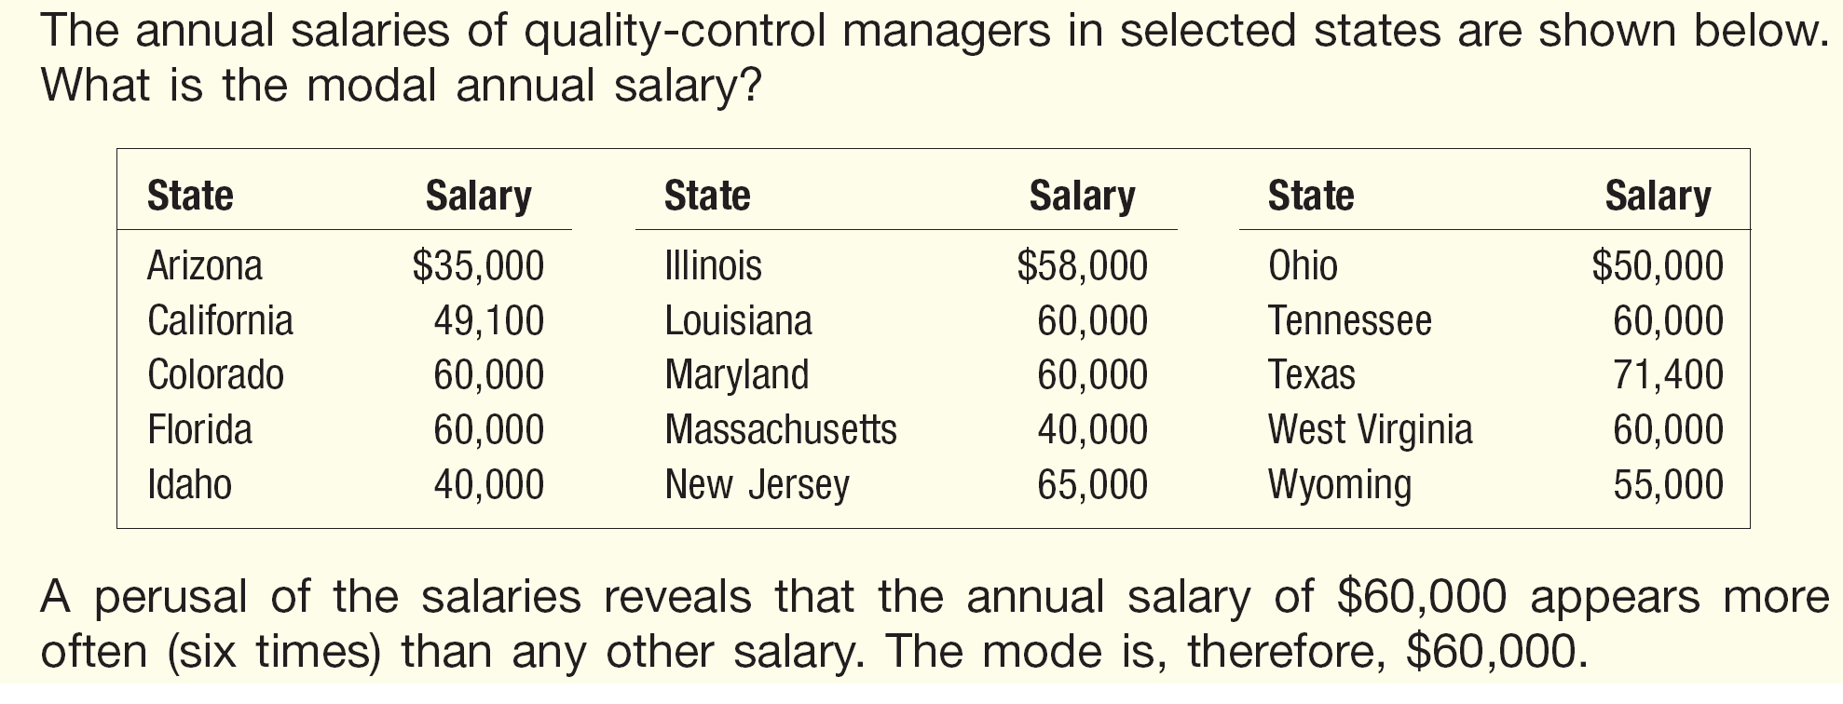
The Mode
MODE The value of the observation that appears most frequently.
Notes:
‹#›

Slide 7
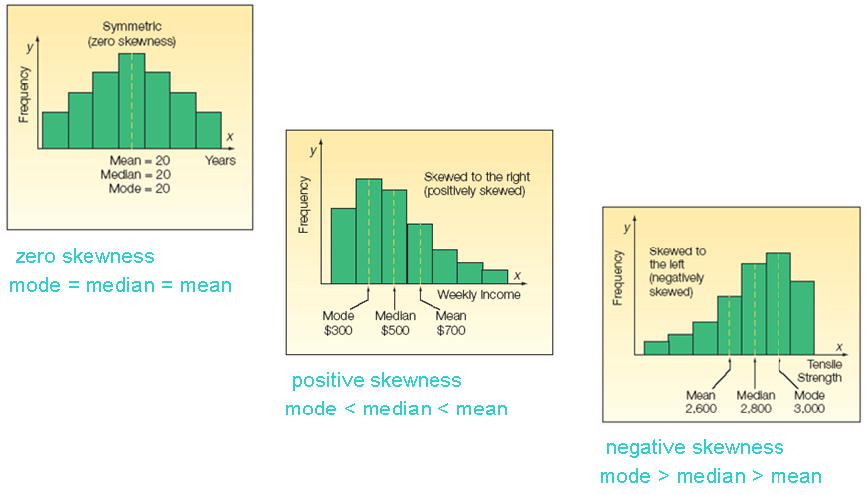
The Relative Positions of the Mean, Median and the Mode
Notes:
‹#›

Slide 8
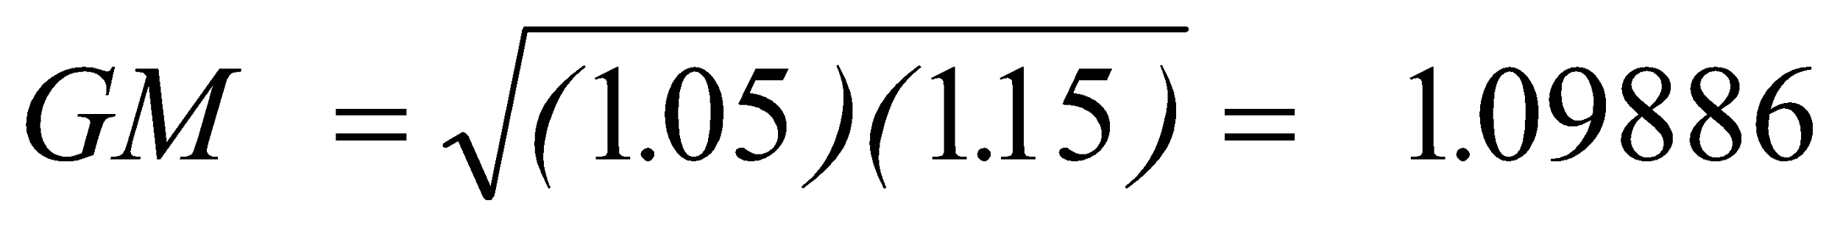
The Geometric Mean
Useful in finding the average change of percentages, ratios, indexes, or growth rates over time.
It has a wide application in business and economics because we are often interested in finding the percentage changes in sales, salaries, or economic figures, such as the GDP, which compound or build on each other.
The geometric mean will always be less than or equal to the arithmetic mean.
The formula for the geometric mean is written:
EXAMPLE:
Suppose you receive a 5 percent increase in salary this year and a 15 percent increase next year. The average annual percent increase is 9.886, not 10.0. Why is this so? We begin by calculating the geometric mean.
Notes:
‹#›

Slide 9
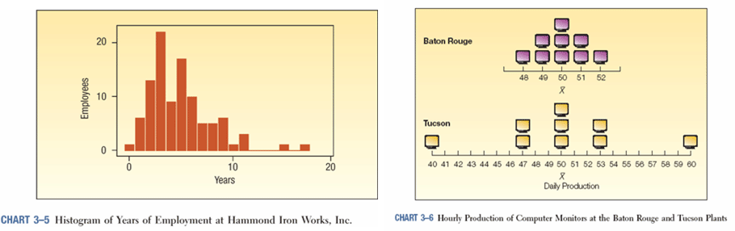
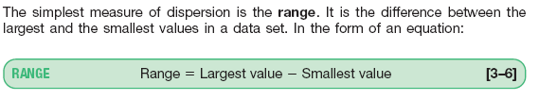


Measures of Dispersion
A measure of location, such as the mean or the median, only describes the center of the data. It is valuable from that standpoint, but it does not tell us anything about the spread of the data.
For example, if your nature guide told you that the river ahead averaged 3 feet in depth, would you want to wade across on foot without additional information? Probably not. You would want to know something about the variation in the depth.
A second reason for studying the dispersion in a set of data is to compare the spread in two or more distributions.
RANGE
MEAN DEVIATION
VARIANCE AND STANDARD DEVIATION
Notes:
‹#›

Slide 10
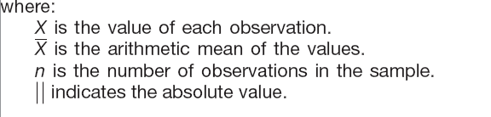
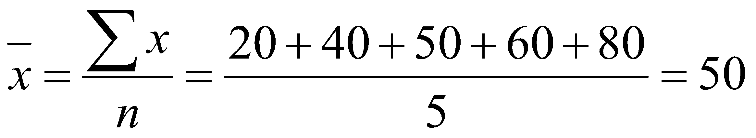
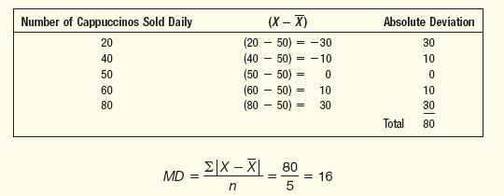
EXAMPLE – Mean Deviation
EXAMPLE:
The number of cappuccinos sold at the Starbucks location in the Orange Country Airport between 4 and 7 p.m. for a sample of 5 days last year were 20, 40, 50, 60, and 80. Determine the mean deviation for the number of cappuccinos sold.
Step 1: Compute the mean
Step 2: Subtract the mean (50) from each of the observations, convert to positive if difference is negative
Step 3: Sum the absolute differences found in step 2 then divide by the number of observations
Notes:
‹#›

Slide 11
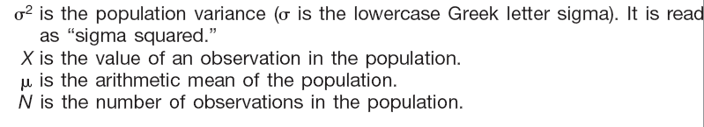
Variance and Standard Deviation
VARIANCE The arithmetic mean of the squared deviations from the mean.
STANDARD DEVIATION The square root of the variance.
The variance and standard deviations are nonnegative and are zero only if all observations are the same.
For populations whose values are near the mean, the variance and standard deviation will be small.
For populations whose values are dispersed from the mean, the population variance and standard deviation will be large.
The variance overcomes the weakness of the range by using all the values in the population
Notes:
‹#›

Slide 12
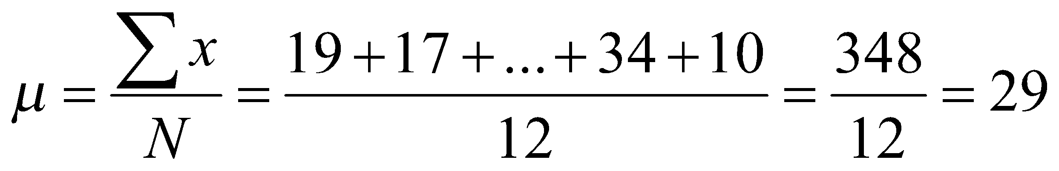
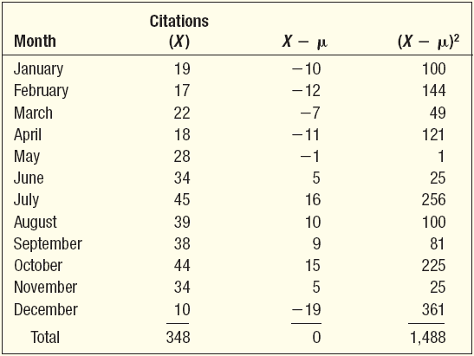
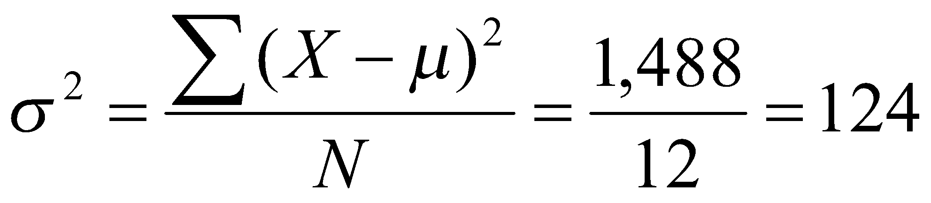
EXAMPLE – Population Variance and Population Standard Deviation
The number of traffic citations issued during the last five months in Beaufort County, South Carolina, is reported below:
What is the population variance?
Step 1: Find the mean.
Step 2: Find the difference between each observation and the mean, and square that difference.
Step 3: Sum all the squared differences found in step 3
Step 4: Divide the sum of the squared differences by the number of items in the population.
Notes:
‹#›

Slide 13

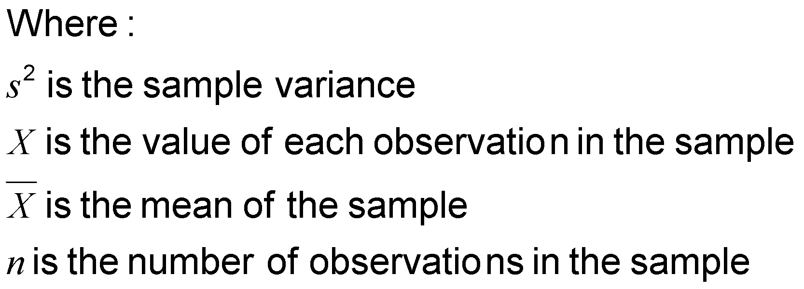
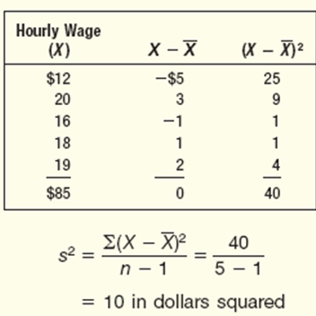
Sample Variance and Standard Deviation
EXAMPLE
The hourly wages for a sample of part-time employees at Home Depot are: $12, $20, $16, $18, and $19.
What is the sample variance?
Notes:
‹#›

Slide 14
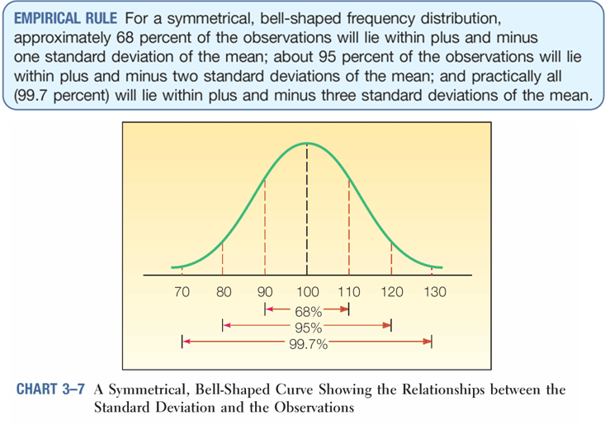
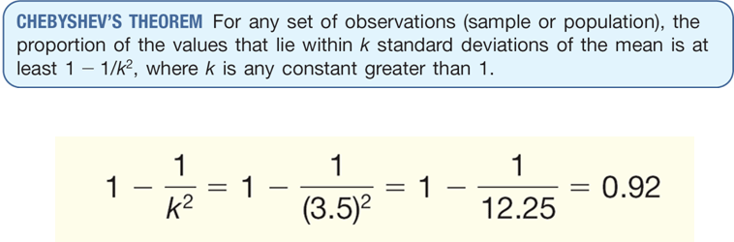
Chebyshev’s Theorem and Empirical Rule
The arithmetic mean biweekly amount contributed by the Dupree Paint employees to the company’s profit-sharing plan is $51.54, and the standard deviation is $7.51. At least what percent of the contributions lie within plus 3.5 standard deviations and minus 3.5 standard deviations of the mean?
Notes:
‹#›

Slide 15
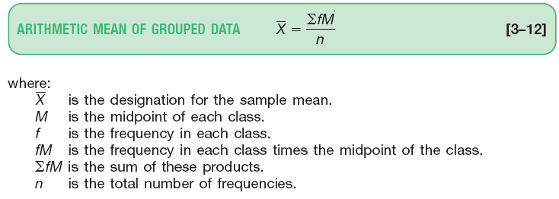
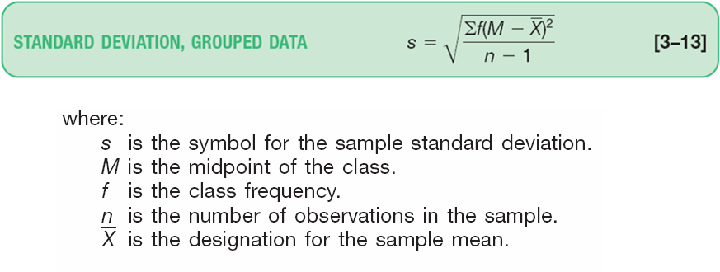
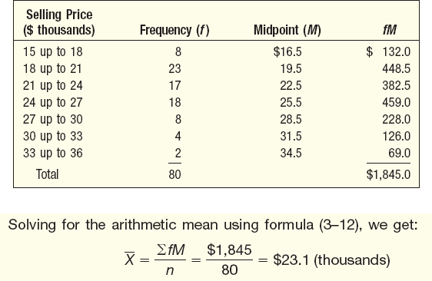
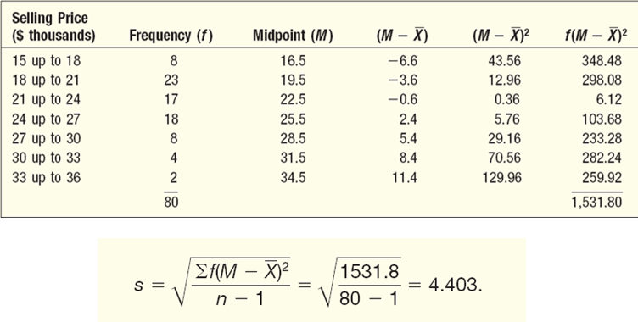
The Arithmetic Mean and Standard Deviation of Grouped Data
EXAMPLE:
Determine the arithmetic mean vehicle selling price given in the frequency table below.
EXAMPLE
Compute the standard deviation of the vehicle selling prices in the frequency table below.
Notes:
‹#›

